Slide 1


Slide 2

Submitted by:
S M Musfikur Rahman (SID : 190224)
Masud Karim Omi (SID : 200220)
Utsa Debnath (SID : 200242)
KHULNA UNIVERSITY
COURSE TITLE: Database System Project
Course No: CSE 3102
Submitted to:
Dr. Md. Anisur Rahman
Professor
Computer Science and Engineering Discipline, Khulna University

Slide 3

LIBRARY MANAGEMENT SYSTEM

Slide 4

CONTENT
INTRODUCTION
MOTIVATION
BENEFITS
INTERESTING QUERIES
TOOLS & TECHNOLOGIES
ER DIAGRAM
SCHEMA
SCHEMA DIAGRAM

Slide 5

LIBRARY MANAGEMENT SYSTEM
INTRODUCTION
Performing library management manually is quite difficult.
These issues should address and answer.
The Library Management System (LMS) is a program that helps librarians
Manage the daily book
Manage the member, and books record more efficiently.
It can improve the property in the library.
Used by librarians and library admin.
Can manage the member maintenance module,
Book maintenance module and
Book transaction module.

Slide 6
LIBRARY MANAGEMENT SYSTEM
MOTIVATION
This study was undertaken to design an advanced database for a library management system for the Seminar Library CSE discipline at Khulna University.
The number of users is changing day by day. To cope with this, the KU library was automating some of the services
the insufficient staff
the classification of the book also creates problems
mismanagement of records since the system was manual affected the level of efficiency of the library.
handle the library services efficiently.

Slide 7
LIBRARY MANAGEMENT SYSTEM
INTERESTING QUERIES
Book search: Find books based on different criteria.
Member management.
Checkout and return
Overdue notices
Member borrowing history
Fine management
Notifications

Slide 8
LIBRARY MANAGEMENT SYSTEM
TOOLS & TECHNOLOGY
Software
Operating system: Windows 11 Home
Database: Microsoft SQL Server 2008
Development tools: Microsoft Visual Studio 2008
Programming language- HTML, CSS, JavaScript, PHP
Hardware
Processor: Intel(R) Core(TM) i5-9500K CPU @ 3.90GHz
Ram: 12 GB

Slide 9
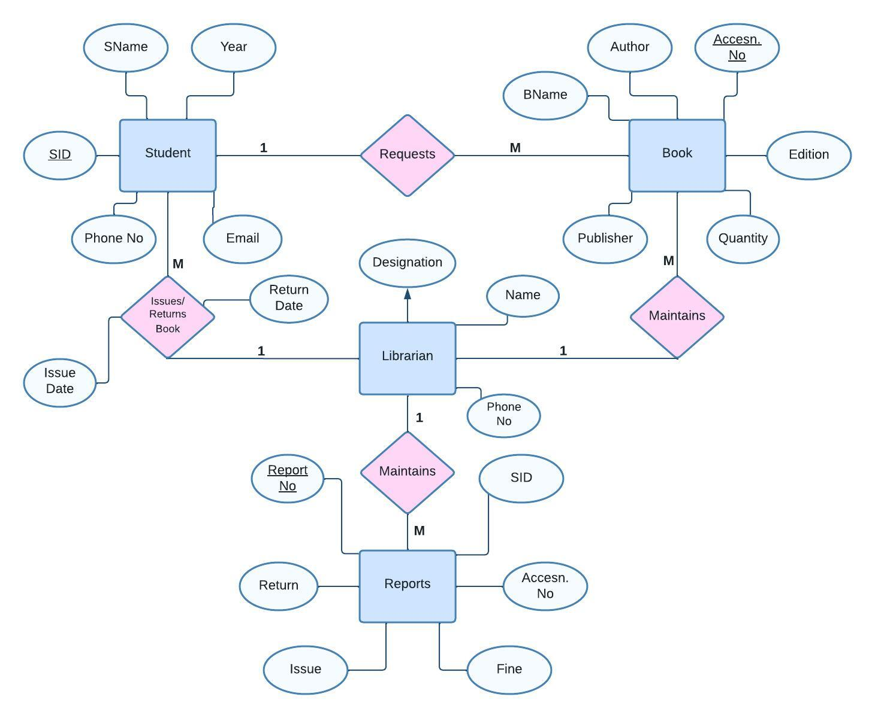
ER DIAGRAM
ER DIAGRAM
LIBRARY MANAGEMENT SYSTEM

Slide 10
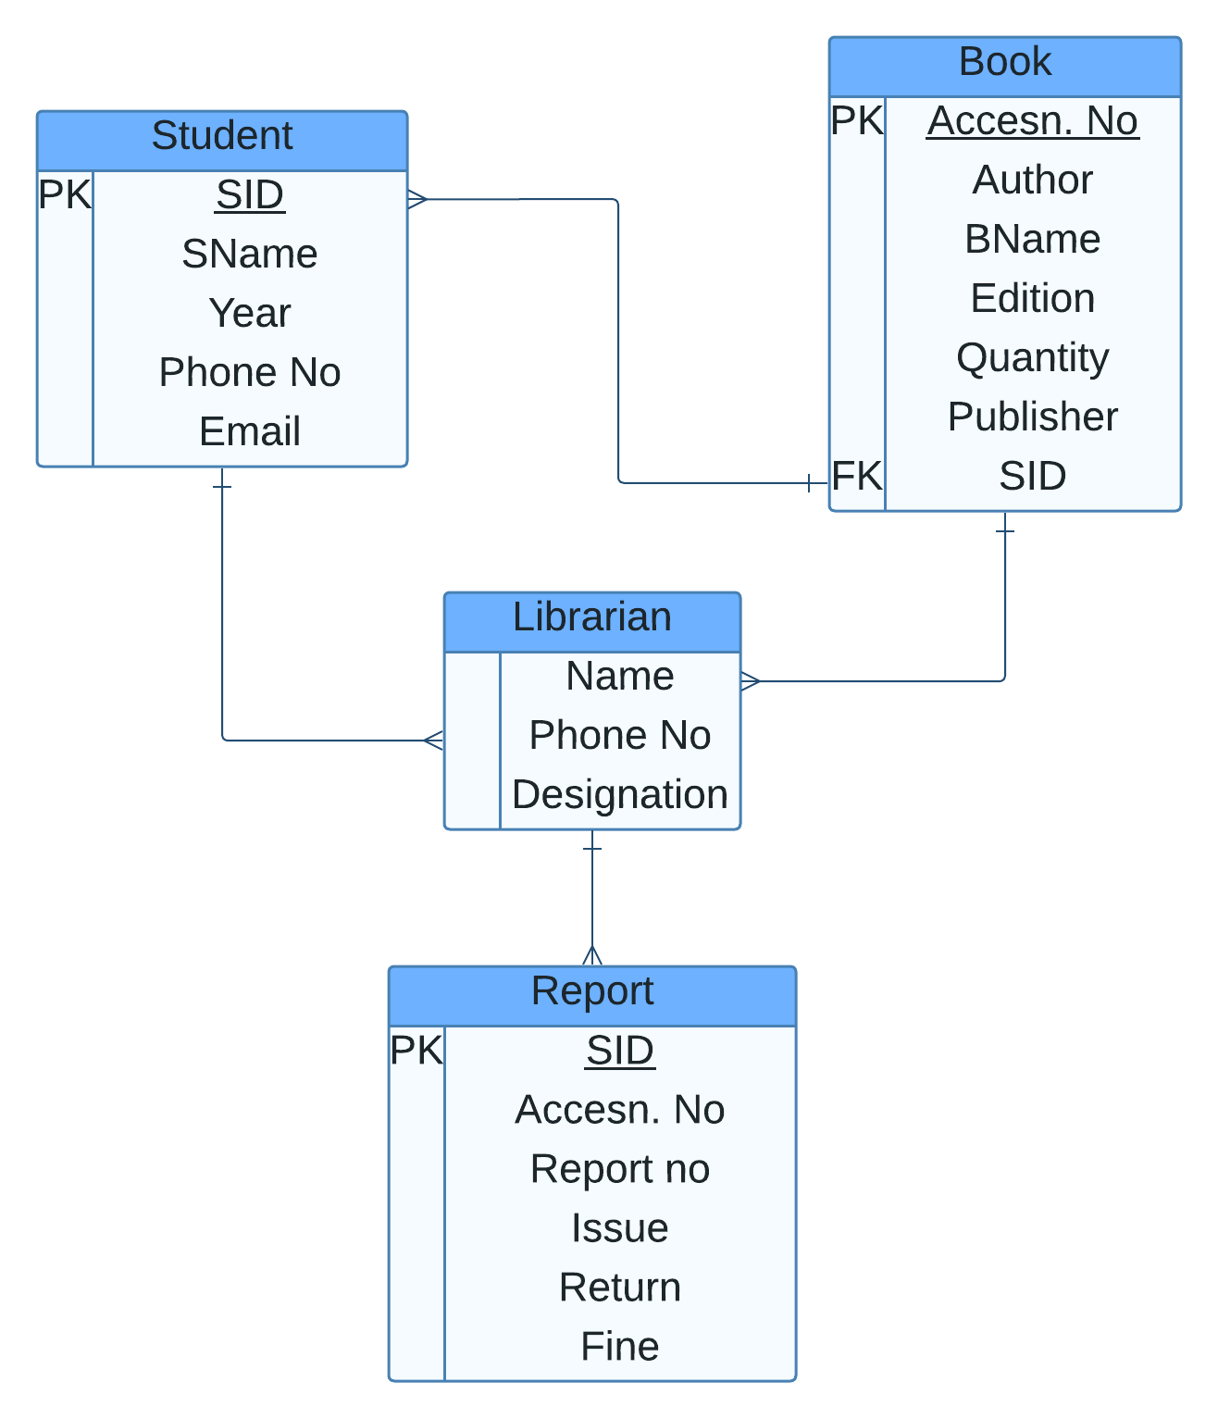
SCHEMA DIAGRAM
LIBRARY MANAGEMENT SYSTEM

Slide 11


